Slide 1
Lasting Powers of Attorney and Deputyship Orders Dementia Action Group 21 September 2023

Slide 2
Grant Saw Solicitors LLP
Established in 1851
Offices in Greenwich and Blackheath
Private Client Department is accredited by the Wills and Inheritance Quality Scheme (WIQS), Society of Trust and Estate Practitioners (STEP) and Solicitors for the Elderly (SFE)
Private Client Department are all trained Dementia friends
Proud to be a part of Dementia Inclusive Greenwich

Slide 3
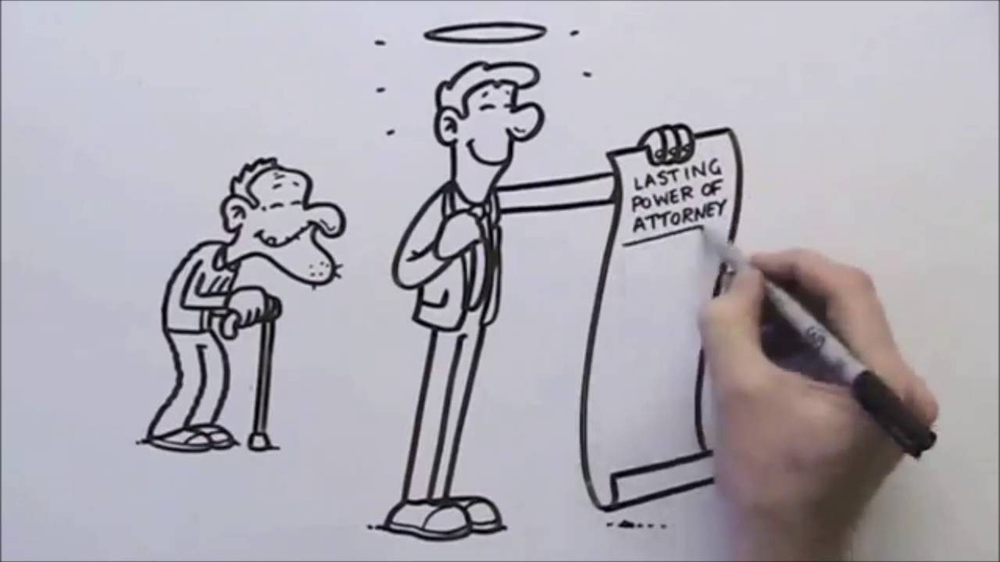
Lasting Powers of Attorney
We see a lot of clients who have had a diagnosis of dementia who wish to get their affairs in order by making a Will and LPAs
Must have capacity to make one
MCA 2005 - decision specific
Does not restrict a person’s right to control their affairs for as long as they are able.
LPA for Property and Financial Affairs and/ or Health and Welfare decisions
An insurance policy if mental capacity lost
Gives the same protection if incapacity or illness
This is not intended to be legal advice

Slide 4
What is involved in making an LPA?
Choose Attorneys wisely as potential for misuse/abuse of power (we can act as Attorneys)
Can choose to notify persons
Certificate Provider
Capacity assessment required?
Complete LPA forms
Register your LPA
Can take up to 24 weeks to register
This is not intended to be legal advice

Slide 5
Deputyship Orders
If a person has already lost capacity then all is not lost
Apply to the Court of Protection for a Deputyship Order
A Deputy is an individual appointed by the Court of Protection to make decisions on behalf of an individual who lacks capacity to take the decisions themselves
Again, two types: Health & Care Deputy and Finance & Property affairs Deputy
But this is more time consuming and expensive than putting an LPA into place
This is not intended to be legal advice

Slide 6
Application to appoint a Deputy
Application must be submitted to the Court of Protection
Detailed information about the circumstances of the incapacitated individual
Evidence of the person’s incapacity
Declaration by the proposed deputy
Can take up to a year from submitting the application to receiving a decision from the Court of Protection
Important not to delay in submitting the application where a deputy is required to act urgently.
CASE STUDY
This is not intended to be legal advice

Slide 7
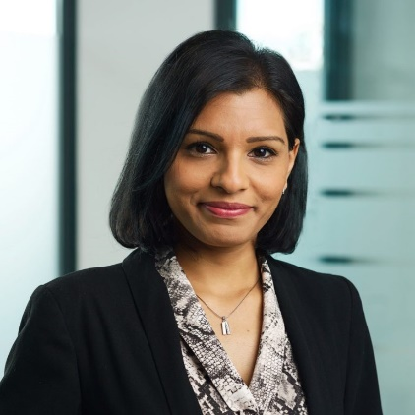
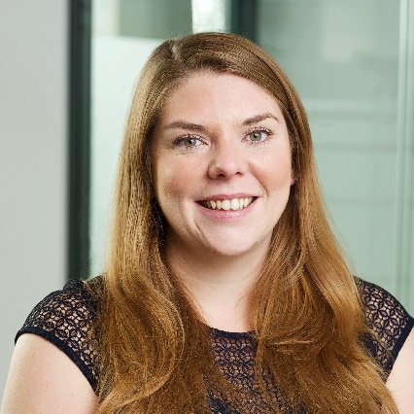
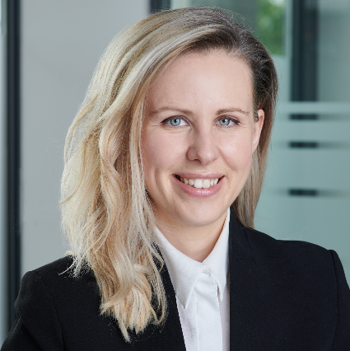
Contact us for help
Kalpa Prajapati
Head of Private Client
kalpa.prajapati@grantsaw.co.uk
020 8305 3536
Charlotte Warren
Solicitor
charlotte.warren@grantsaw.co.uk
020 8305 4231
Tatiana Zenina
Solicitor
tatiana.zenina@grantsaw.co.uk
020 8305 4239
Jeremy Brooks
Solicitor
jeremy.brooks@grantsaw.co.uk
020 8305 3534
privateclient@grantsaw.co.uk
020 8858 6971

